Slide 1
Chapter 1:
Network Elements
A First Course in Network Science

Slide 2
The plan
In the previous chapter we saw a bunch of interesting networks arising in many different domains
Now let us learn the language of networks
  The components: nodes, links
  Types of networks and representations
  Features of nodes and links

Slide 3
We want to be able to talk about...
properties to characterize structure & behavior of networks
roles of networks in affecting processes occurring on network structures

Slide 4
Formal definitions
A network or graph G has two parts, a set of N elements, called nodes or vertices, and a set of L pairs of nodes, called links or edges. The link (i, j) joins the nodes i and j. Two nodes are adjacent or connected or neighbors if there is a link between them.
A network can be undirected or directed. A directed network is also called a digraph. In directed networks, links are called directed links and the order of the nodes in a link reflects the direction: the link (i, j) goes from the source node i to the target node j. In undirected networks, all links are bi-directional and the order of the two nodes in a link does not matter.
A network can be unweighted or weighted. In a weighted network, links have associated weights: the weighted link (i,j,w) between nodes i and j has weight w. A network can be both directed and weighted, in which case it has directed weighted links.

Slide 5
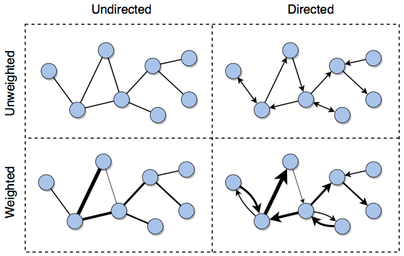
Can you think of a few examples in each of these categories?

Slide 6
Python and NetworkX
import networkx as nx # always!
G = nx.Graph()
G.add_node(1)
G.add_nodes_from([2,3,…])
…
G.add_edge(1,2)
G.add_edges_from([(2,3),(2,4),…])
…
G.nodes()
G.edges()
G.neighbors(4)
for n in G.nodes:
print(n, G.neighbors(n))
for u,v in G.edges:
print(u, v)
3
1
4
5
2
6

Slide 7
Directed networks
import networkx as nx # don’t forget!
D = nx.DiGraph()
D.add_edge(1,2)
D.add_edge(2,1)
D.add_edges_from([(2,3),(3,4),…])
…
D.number_of_nodes()
D.number_of_edges()
D.edges()
D.successors(2)
D.predecessors(2)
D.neighbors(2)
3
1
4
5
2
6

Slide 8
Weighted networks
3
W = nx.Graph()
W.add_edge(1,2,weight=6)
…
W.add_weighted_edges_from([(4,5,3),(4,6,5),…])
…
W.edges()
W.edges(data='weight')
for (u,v,d) in W.edges(data='weight'):
if d>3:
print('(%d, %d, %d)’%(u,v,d))
1
3
3
5
6
4
4
3
5
2
6

Slide 9
Bipartite networks
In a bipartite network, there are two groups of nodes such that links only connect nodes from different groups and not nodes from the same group
Examples of bipartite networks include those that capture the relationships between movies and stars, between songs and artists, between classes and students, and between products and customers

Slide 10
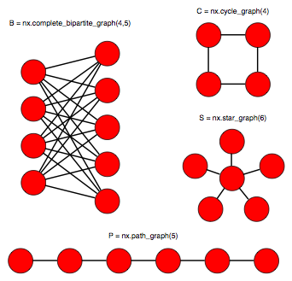
Many networks generators

Slide 11
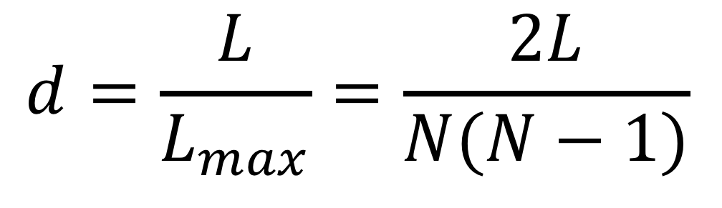
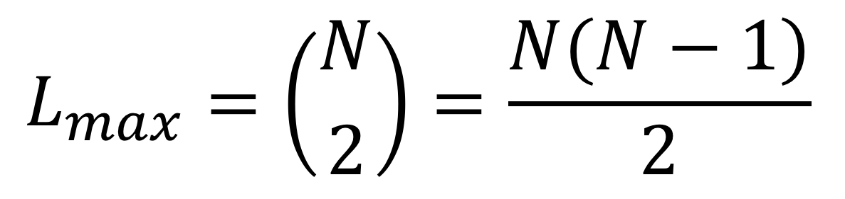
Density and sparsity
Network size N = number of nodes
L = number of links
Maximum possible number of links:
Density:
The network is sparse if d << 1
$$L_{max}=\left({N \atop 2}\right)=\frac{N(N−1)}{2}$$
$$d=\frac{L}{L_{max}}=\frac{2L}{N(N−1)}$$

Slide 12
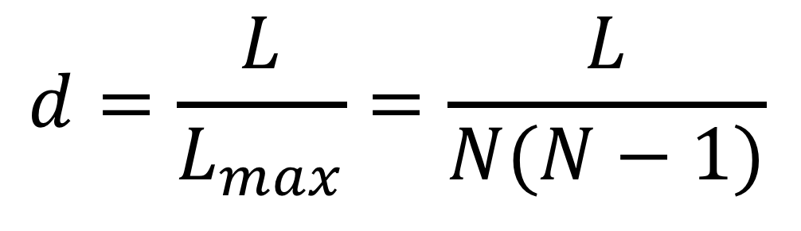
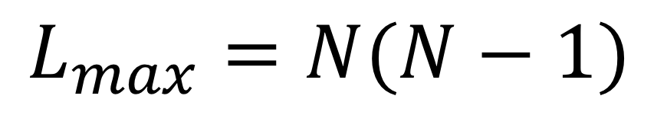
Density and sparsity
In a directed network things are a bit different…
  Maximum possible number of links:
  Density:
In a complete network, all pairs of nodes are connected and d = 1
$$L_{max}=N(N−1)$$
$$d=\frac{L}{L_{max}}=\frac{L}{N(N−1)}$$
G.number_of_nodes()
G.number_of_edges()
nx.density(G)
nx.density(D)
CG = nx.complete_graph(8471)
print(nx.density(CG)) # what does this print?

Slide 13
Example: Facebook
Rough orders-of-magnitude approximations:
N ≈ 10⁹
L ≈ 10³ x N
d ≈ L / N² ≈ 10³ N / N² ≈ 10³ / 10⁹ = 10⁻⁶
Most (but not all) real-world networks are similarly sparse because the number of links scales proportionally to N, whereas the maximum scales with N²

Slide 14
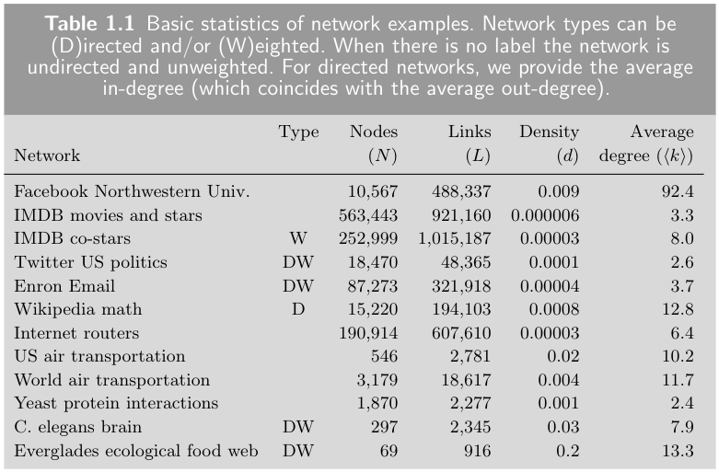

Slide 15
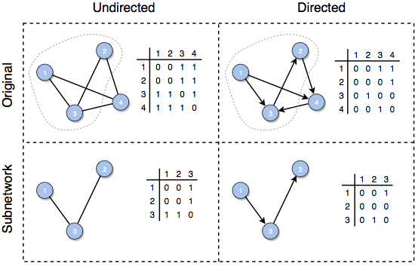
Subnetworks
A subnetwork is a network obtained by selecting a subset of the nodes and all of the links among these nodes
A clique is a complete subnetwork
S = nx.subgraph(G, node_list)

Slide 16
Degree
The degree of a node is its number of links, or neighbors
We typically use ki to denote the degree of node i
A node without neighbors is called a singleton (k=0)
G.degree(2) # returns the degree of node 2
G.degree() # dict with the degree of all nodes of G

Slide 17
Degree
In a directed network we have
  in-degree of a node = number of incoming links k^{in}i
  out-degree of a node = number of outgoing links k^{out}i
D.in_degree(4)
D.out_degree(4)
D.degree(4)

Slide 18


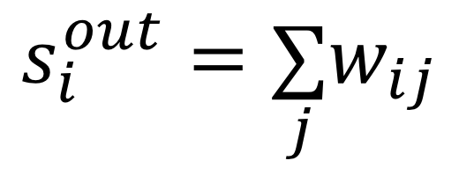
Strength
$$s_{i}=\underset{j}{∑}w_{ij}$$
In a weighted network we have strength (a.k.a. weighted degree)
In a weighted directed network we have
  in-strength
  out-strength
$$s_{i}^{in}=\underset{j}{∑}w_{ji}$$
$$s_{i}^{out}=\underset{j}{∑}w_{ij}$$
W.degree(4) # degree
W.degree(4, weight='weight') # strength

Slide 19
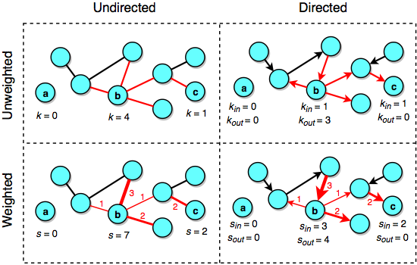

Slide 20
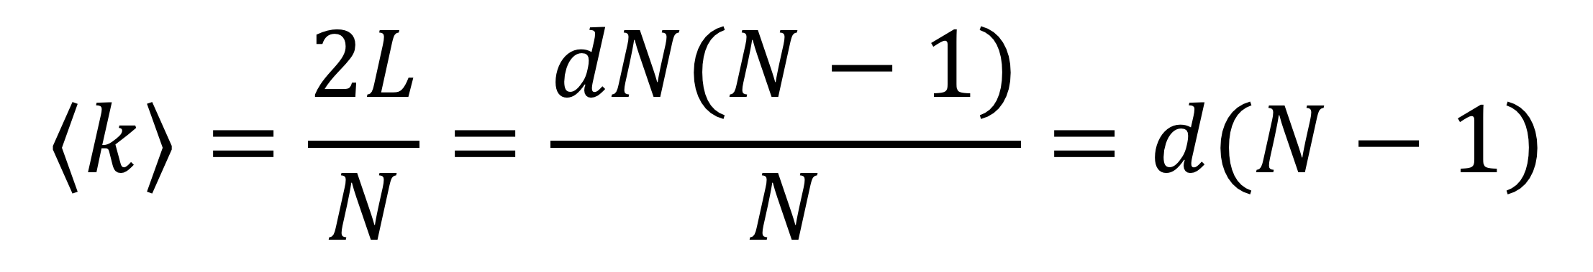
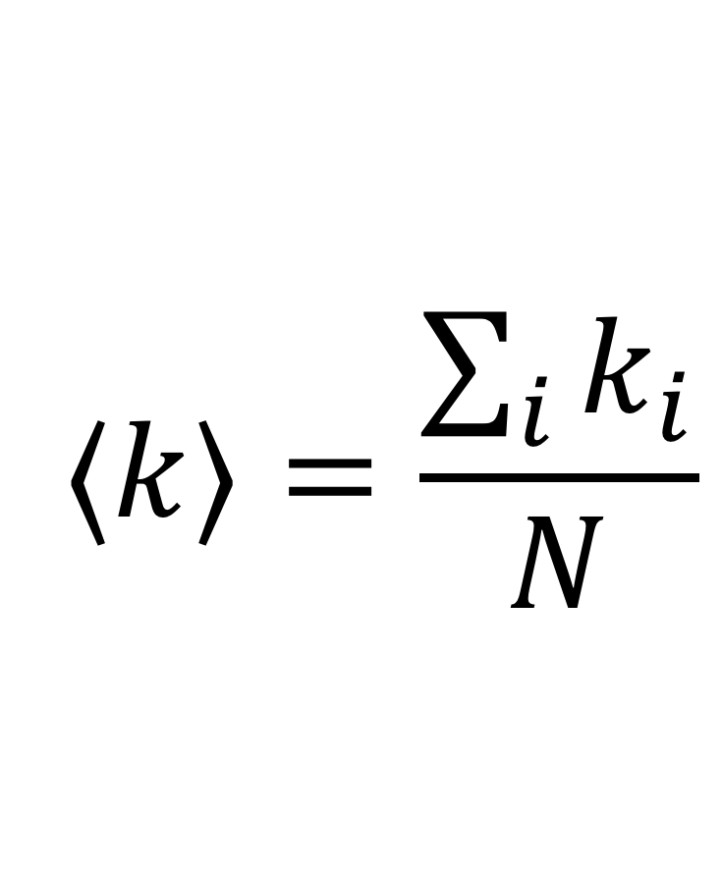
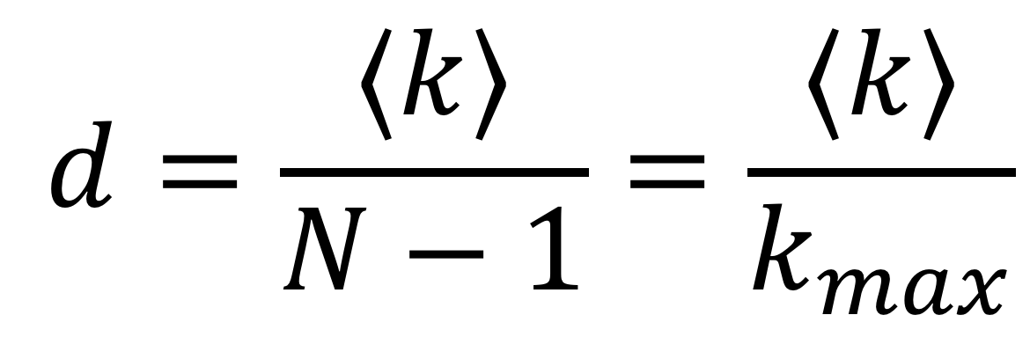
Average degree
The average degree of a network is
We can connect network size, number of links, density, and average degree
In undirected networks:
$$⟨k⟩=\frac{\sum_{i}{k_{i}}}{N}$$
$$⟨k⟩=\frac{2L}{N}=\frac{dN(N−1)}{N}=d(N−1)$$
$$d=\frac{⟨k⟩}{N−1}=\frac{⟨k⟩}{k_{max}}$$

Slide 21
Multilayer networks
A network can have multiple layers, each with its own nodes and edges
  Example: air transportation networks of distinct airlines, with some but not complete overlap of airport nodes
Intralayer links among nodes in the same layer, interlayer links across layers
If the sets of nodes in the different layers are identical, we call the network a multiplex; interlayer links are couplings linking the same node across layers
  Example: layers to represent different types of relationship in a social network, such as friendship, family ties, coworkers, etc.

Slide 22
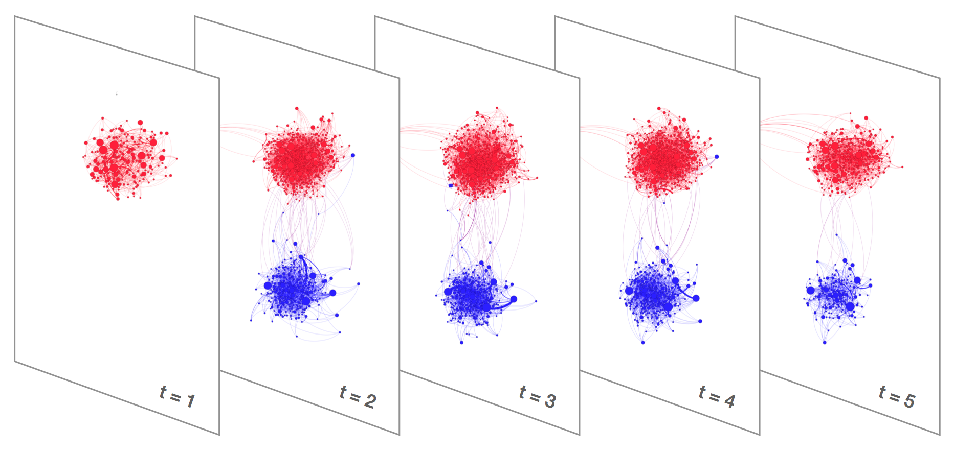
Temporal networks
A temporal network is a multiplex in which the layers represent links at different times (temporal snapshots)
  Example: a Twitter
  retweet network

Slide 23
Networks of networks
In general, each layer in a multilayer network can have its own nodes and edges. We call this a network of networks
  Examples: the electrical power grid and the Internet; also the Internet itself!
The interactions between networks in the different layers are captured by the interlayer links
  Example: power stations communicate via the Internet, Internet routers are powered by the power grid
  Cascading failures are one type of unpredictable vulnerabilities that arise in networks of networks

Slide 24
Simplifying assumptions
We will assume:
  single-layer networks with a single type of nodes and a single type of link
  no self-loops
  at most a single link between two nodes (possibly two links with opposite directions in directed networks)
No!
No!
No!

Slide 25
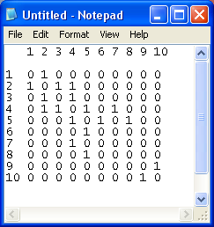
Network representations
3
6
1
8
4
5
Adjacency matrix: N x N matrix where each element aij = 1 if i and j are adjacent, zero otherwise
The diagonal elements are zero because we have no self-loops
In undirected networks, the matrix is symmetric:
aij = aji
7
2
10
9
nx.adjacency_matrix(G)
print(nx.adjacency_matrix(G))
G.edge[3][4]
G.edge[3][4]['color']='blue'
G.edge[3][4]
G.edge[4]

Slide 26
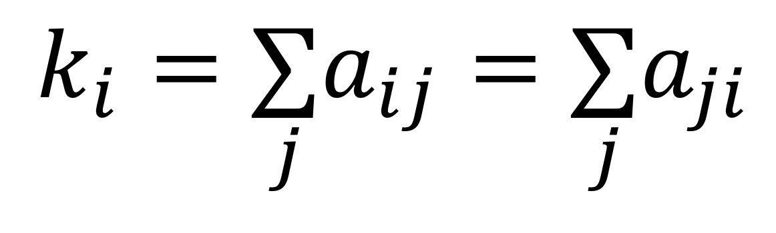
Network representations
3
6
1
8
4
5
7
In undirected networks, the degree is obtained by summing adjacency matrix elements across rows or columns:
2
10
9
$$k_{i}=\underset{j}{∑}a_{ij}=\underset{j}{∑}a_{ji}$$

Slide 27
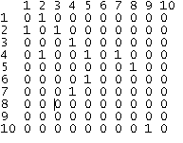
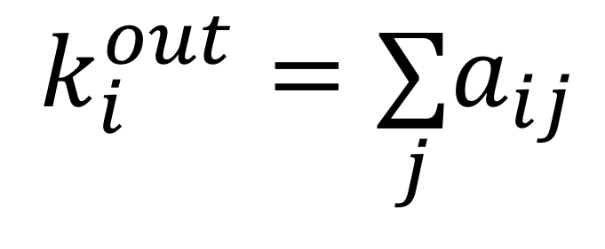
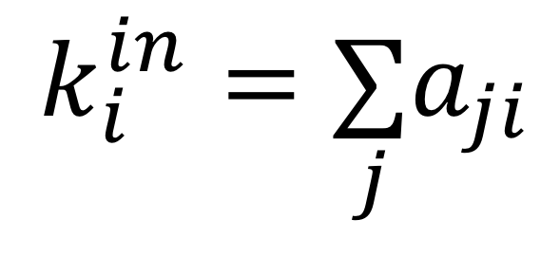
Network representations
6
3
1
8
5
4
7
In directed networks, the adjacency matrix is not symmetric
The out-degree is obtained by summing adjacency matrix elements across rows:
The in-degree is obtained by summing adjacency matrix elements across columns:
2
10
9
$$k_{i}^{out}=\underset{j}{∑}a_{ij}$$
$$k_{i}^{in}=\underset{j}{∑}a_{ji}$$
print(nx.adjacency_matrix(D))
D.edge[3][4]
D.edge[4][3]
D.edge[4]

Slide 28
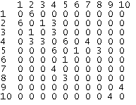
Network representations
6
3
1
3
1
1
6
8
6
4
5
3
In weighted networks, each element wij represents the weight of the link between i and j, zero if there is no link
If undirected, the strength is obtained by summing adjacency matrix elements across rows or columns
If directed, the in/out-strength is obtained by summing adjacency matrix elements across columns/rows
3
4
7
2
10
4
9
print(nx.adjacency_matrix(W))
W.edge[2][3]
W.edge[2]
W.edge[2][3]['weight'] = 2
W.edge[2][3]
W.edge[2]

Slide 29
Sparse network representations
The memory/disk storage needed by an adjacency list is proportional to N²
In sparse networks (most real-world networks), this is terribly inefficient: most of the space is wasted storing zeros (non-links); for very large networks, adjacency lists are unfeasible
It is much more efficient, often necessary, to store only the actual links, and assume that if a link is not listed it means it is not present
There are two commonly used sparse networks representations:
  Adjacency list
  Edge list

Slide 30
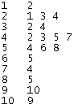
Adjacency list
3
6
1
8
List of neighbors for each node
In undirected networks, each link is listed twice
In weighted networks, each neighbor is replaced by a pair (neighbor, weight)
4
5
7
2
10
9
G.neighbors(2)
for n,neighbors in G.adjacency():
for neighbor,link_attributes in neighbors.items():
print('(%d, %d)' % (n,neighbor))
nx.write_adjlist(G, "netfile.adjlist")
G2 = nx.read_adjlist("netfile.adjlist") # G and G2 are isomorphic

Slide 31
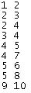
Edge list
3
6
1
8
4
5
List of node pairs that are connected
In weighted networks, each pair is replaced by a triple (i, j, weight)
7
2
10
9
for i,j in G.edges:
print('%d %d' %(i,j))
nx.write_edgelist(G, "netfile.edgelist")
G3 = nx.read_edgelist("netfile.edgelist") # G and G3 are isomorphic
nx.write_weighted_edgelist(W, "wf.edges") # store weights
W2 = nx.read_weighted_edgelist("wf.edges") # W and W2 are isomorphic

Slide 32

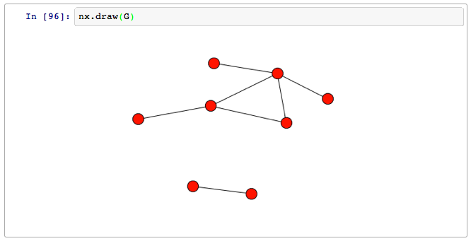
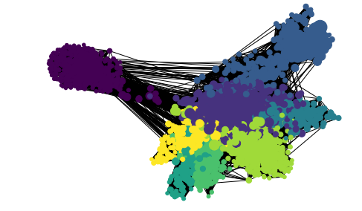
Drawing networks
A network layout algorithm places nodes on a plane to visualize the structure of the network
There are many layout algorithms; the most commonly used are force-directed layout (a.k.a. spring layout) algorithms:
  Connected nodes are placed near each other
  Links have similar length
  Link crossings are minimized
This is done by simulating a physical systems where adjacent nodes are connected by springs and otherwise repel each other
The community structure of the network can be revealed this way if the network is not too dense or too large
import matplotlib.pyplot
nx.draw(G, node_color=colors, node_size=sizes)

